Slide 1
UNCLASSIFIED –cleared for public release
ORS Program Status
16 October 2012
Working Group on Space-based Lidar Winds
Boulder CO
Thomas.Adang@kirtland.af.mil
505-846-3115
Distribution A: Cleared for Public Release
UNCLASSIFIED – Cleared for Public Release

Slide 2
Outline
Unclassified Cleared for Public Release
Background
Funding Uncertainty in FY13
Potential ORS Weather Mission
Currently Programmed ORS Missions
Summary
Unclassified Cleared for Public Release

Slide 3
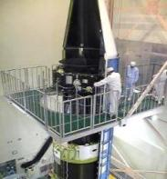
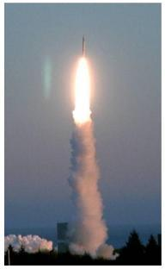
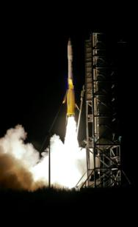
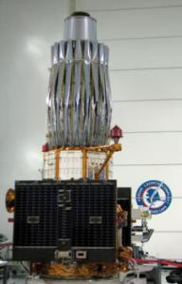

Four Years Four Launches
UNCLASSIFIED – CLEARED FOR PUBLIC RELEASE
ORS Office Established : May 2007
July 2008
1st Rapid Transport & Integration
JUMPSTART Demo
May 2009
1st Tactical
HSI
AFRL’s TacSat-3
Jun 2011
1st Dedicated COCOM ISR
ORS-1
Sep 2011
1st Comm-on-the-Move
NRL’s TacSat-4
Wallops Flight Facility/ MARS
Wallops Flight Facility/ MARS
6 Day Call Up
To
Launch
Transitioned to Operations
June 2010
Transitioned to Operations
Jan 2012
Demo Modular Bus Standards
& Military Utility
Rapid Development – Relevant to the Warfighter
UNCLASSIFIED – CLEARED FOR PUBLIC RELEASE
Notes:
Since the Office stood up in May 2007, we have delivered capabilities to the warfighter by using novel approaches and leveraging what already exists and closing collaborating with the community. These are amazing successes in a budget constrained environment. The successes will be highlighted more throughout this talk.

Slide 4

















ORS Office Objectives
Unclassified Cleared for Public Release
Two Primary Tasks:
Develop End-to-End Enabling Capabilities
Respond to Joint Force Commanders’ Needs
Kodiak Launch Complex
MMSOC
Rapid Assembly, Integration and Testing (AI&T)
NASA Wallops
Mid Atlantic Regional Spaceport
Minotaur Family of Launch Vehicles
Virtual Mission Ops and Control
Modular Open Systems Approach
Plug-n-Play Technologies
Cape Canaveral
Super Strypi
Tactical TPED
Common Data Link
Vandenberg AFB
Responsive Command & Control , Tasking, Processing, Exploitation & Dissemination
Responsive
Buses/Payloads & Manufacturing
RAPTOR
Responsive Launchers
Responsive Ranges
Kwajalein
Unclassified Cleared for Public Release
Notes:
As directed by the Commander of Strategic Command, the ORS Office has two overarching objectives,
1. To build the enabling infrastructure and CONOPs necessary to deploy existing capabilities in weeks and new capabilities in less than a year And --
2. To respond to the urgent needs of the JFCs
To achieve these timelines we are developing the infrastructure to deliver capabilities to the warfighter quickly by using an open innovation process that focuses on a modular open systems approach that encompasses the following:
PnP Buses and Modular payloads
- Having launch assets waiting or quickly configured
- Having ranges that are interoperable, space-based and adaptable to unforeseen events
- And, embracing new concepts of operations
Our approach builds the enabling infrastructure to respond to the critical and unanticipated needs of the warfighter in operationally relevant timelines. I’m going to step through specific examples and concepts to achieve this end state.
4

Slide 5
ORS Office Priorities
Unclassified Cleared for Public Release
Schedule
Driven by Joint Force Commanders’ timeliness requirements
Enabled by taking “capabilities based” approach to acquisition (vice “requirements based”)
Threshold Performance
“Good enough” capability determined in dialogue with military user
Enabled by focus on “state of the world” technology
Design to Cost Goals
Congress set production cost goals of $40 million for space vehicle and $20 million for launch (approximately $70-75 million per mission)
Acceptable risk
Decided by tailored mission assurance processes
Missions may accept “single string” components
Mission design life typically 1-3 years
Unclassified Cleared for Public Release

Slide 6
FY13 ORS Office Budget Uncertainty
Unclassified Cleared for Public Release
FY13 President’s Budget Request (PBR) terminated ORS program and transferred $10M to SMC
$10M spread across five programs
Intended to better integrate ORS concepts into entire space architecture
Congress rejected legislative proposal to close the ORS Office
Both Authorization Committees supportive of keeping stand-alone Office
Budget marks
House Armed Services Committee (HASC) and Senate Armed Services Committee (SASC) marked and added funds for ORS
House Appropriations Committee-Defense (HAC-D) supported PBR
Senate Appropriations Committee-Defense (SAC-D) added $100M for ORS and transferred $10M from SMC ($110M total for FY13)
Congressional conference committee meetings not yet scheduled
High likelihood that ORS Office will remain as “stand alone” office
Unclassified Cleared for Public Release

Slide 7
FY13 ORS Office Budget Uncertainty
Unclassified Cleared for Public Release
SASC: +$45M (and up to +$60M--FY12 funds) -- Restores $10.0M proposed by PBR to be taken from ORS; adds $35M to continue working with COCOMs (PACOM in particular) on low cost responsive satellites similar to ORS-1
Moves the ORS Office reporting chain from the DoD EA4S to SMC/CC and PEO Space; requires geographic separation from HQ SMC; establishes a 4-person Executive Committee
Authorizes a transfer up to $60.0 million in FY 2012 funds from the Weather Satellite Follow-on program for the ORS Office to build a low-cost, high-TRL (technology readiness level) weather satellite
HASC: +$25M -- Continues ORS; directs an EA4S ORS strategic plan by 30 Nov 2012; rejects DoD proposal to repeal ORS portion of FY07 NDAA (law establishing ORS Office)
HAC-D: President’s Budget Request
SAC-D: Provides $110M to ORS ($10M transfer; $100M plus-up)
Unclassified Cleared for Public Release

Slide 8
DoD METOC Requirements JROC Memo, 15 June 2012
Unclassified Cleared for Public Release
The DoD Joint Requirements Oversight Council (JROC) recently endorsed a list of meteorological and oceanographic collection (METOC) gaps which are to be addressed in a subsequent analysis
The collection gaps are prioritized into three categories:
Cat A: parameters insufficiently met by space and ground-based system which may potentially lead to mission failure (subsequent analysis will investigate)
Cat B: parameters not fully met; additional collection would improve ops and/or no mission failure if not met
Cat C: parameters sufficiently met by ground-based and/or partner space-based systems
An analysis of alternatives (AoA) will focus on solutions to meet Category A gaps which represent a range of performance around the documented minimum values to inform the capability cost curve
Unclassified Cleared for Public Release

Slide 9
DoD METOC Requirements Category A Prioritized Gaps
Unclassified Cleared for Public Release
Parameter | Gap Date
1. Cloud Characterization | 2025
2. Theater Weather Imagery | 2025
3. Ocean Surface Vector Winds | 2015
4. Ionospheric Density | 2023
5. Snow Depth | 2025
6. Soil Moisture | 2021
7. Equatorial Ionospheric Scintillation | 2023
8. Tropical Cyclone Intensity | 2021
9. Sea Ice Characterization | 2025
10. Auroral Characterization | 2025
11. LEO Energetic Charged Particle Characterization | 2021
12. Electric Field | 2025
Unclassified Cleared for Public Release

Slide 10
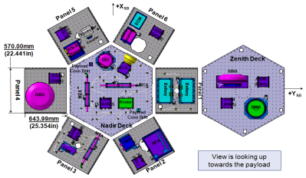
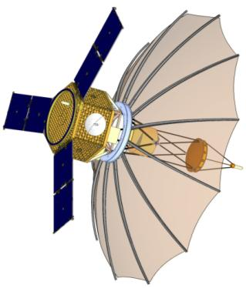
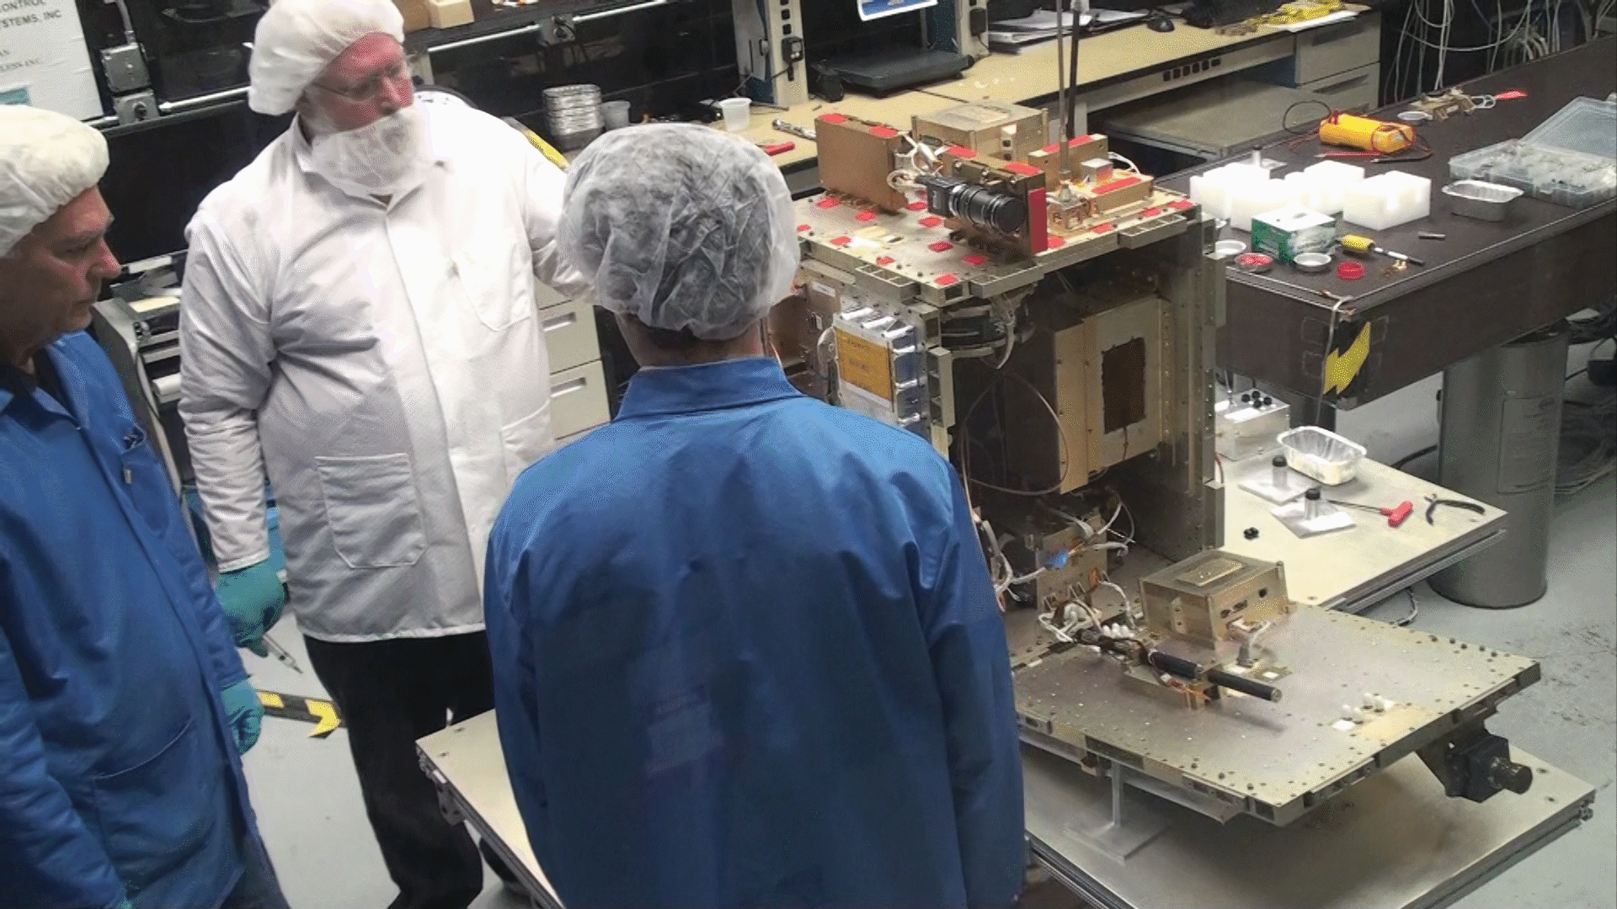
ORS-2 MSV/SAR Mission
Unclassified Cleared for Public Release
Mission Description:
Major Customers: USPACOM, USSTRATCOM
Contractors:
Space Vehicle Bus: Northrop Grumman
Radar Payload: Sierra Nevada (P)/Harris (S)
LV: Orbital Systems Corporation (TBD)
C2 system: Blossom Point Facility
Tasking System: NRL/General Dynamics
Mission Data Processing: DCGS VIP-C
Ground & Space Antenna: L3 Communications West
Led by ORS Office
MSV Bus
SAR PL Feed
Integrated In Antenna Tower
ORS-2 Spacecraft
RRSW
Schedule:
Program Start (11/10)
System Requirements Review (6/11)
Preliminary Design Review (11/11)
Critical Design Review (~5/12)
MSV Bus Delivery (~6/13)
SAR PL Delivery (TBD)
SV integration and testing complete (TBD)
Launch aboard Minotaur 4/Taurus rocket from NASA Wallops Island facility (TBD)
Launch and early orbit activities at Blossom Point (TBD)
Program Objectives:
Develop multi-mission bus and payload architecture
Develop operationally relevant radar capability in support of PACOM
Develop rapidly configurable, multi-mission RF payload architecture
Description: Radar imaging satellite giving CDR PACOM a tactically responsive platform
Autonomous Satellite Ops from Blossom Point Common Ground Architecture
Graduation Exercise for critical ORS enablers - Modular Plug-and-Play Bus, Modular Reconfigurable RF Payload, Rapid Response Space Works, and Ka-CDL
Unclassified Cleared for Public Release

Slide 11
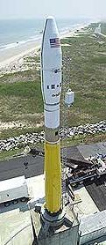






ORS-3 Mission
Unclassified Cleared for Public Release
Mission Description:
Launch Vehicle: Minotaur I Large Fairing
Launch Site: Wallops Flight Facility
Orbit: 40.5 degrees, 500km Circular
Launch Date: 2 August 2013
Launch Contractor: Orbital Sciences
Primary Space Vehicle: STPSat-3
Secondary Payloads: 2 CubeSat Wafers w/minimum of 16 3U CubeSats
Experiments: Drag Device, AFSS
ORS Mission Manager: Steve Buckley
ORS Mission Lead: Mel Herrera
FAA
License
Schedule:
Mission Kick Off: 22 Feb, Chandler AZ
Manifest Decision: 15 March, Kirtland AFB
Systems Requirement Review: 29 March 2012
Mission Design Review 1: 28 Aug 2012
Mission Design Review 2: 5 Feb 2013
Range Kick Off: May 2012
Integrated PL Stack Buildup: 1 May 2013
Pre-Ship Review: 6 June 2013
IPS Ship to Range: 2 July 2013
Begin Range Campaign: 15 June 2013
Initial Launch Capability (ILC): 2 Aug 2013
Objectives:
Demonstrate Automated Launch Vehicle Orbital Targeting Process
Demonstrate Automated Range Safety Planning Process
Develop Autonomous Flight Safety System (AFSS); significant launch and range O&M cost reductions
Launch 27 additional payloads made up of free-flyer Space craft and non-separating experiments
Utilize commercial-like procurement (FAA certification)
Use CubeSat Wafers –allows secondary payload capability taking advantage of excess lift
Unclassified Cleared for Public Release

Slide 12
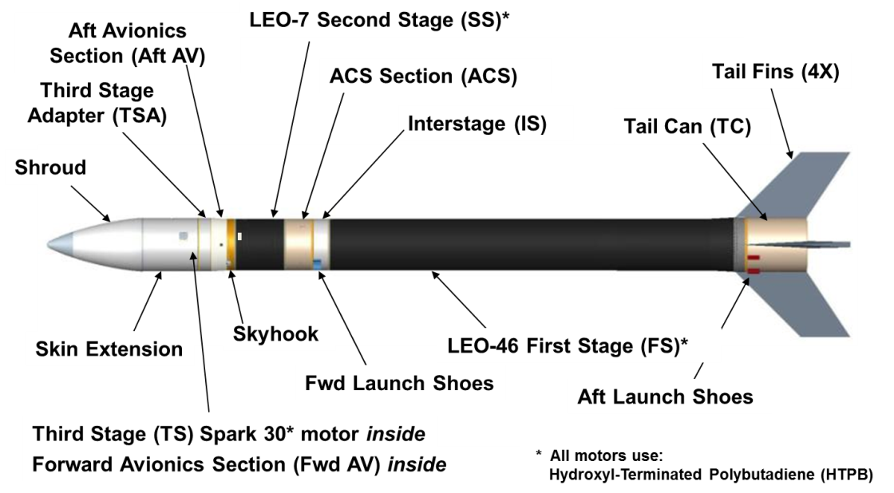
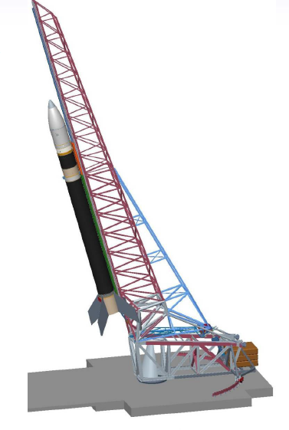
ORS-4 Super Strypi Mission
Unclassified Cleared for Public Release
Mission:
Launch Vehicle: Super Strypi
Launch Site: PMRF
Orbit: 97.03 degrees, 450km x 525km
Launch Date: Sep-Oct 13
Mission Management: ORS Office
Primary Space Vehicle: HiakaSat
Secondary Payloads: NASA Ames x 5, AFRL, ORS Sqrd (slots remaining)
Experiments: AFSS
ORS Mission Manager: Steve Buckley
ORS Mission Lead: Sam McCraw
Schedule:
Mission Kick Off: 11 April 12
LEO-46 Static Fire: Spring 13
LEO-7 Static Fire: 23 Jul 12
Delta CDR:28-30 Aug 12
Aerojet Contract Award: ~10/15/12
LEO-1 Static Fire: Spring 13
Pathfinder: Aug 13
Launcher Refurbishment Contract Award: Nov 12
Pad 41 Contract Award: ~Dec 12
ILC: Sep-Oct ‘13
Program Objectives:
Long Term Super Strypi
Develop launch system to exploit the 21st century range
Reduced infrastructure - AFSS, GPS metric tracking, space-based telemetry relay, automated flight planning
300kg/475km/45-degree inclination
$15M fly-away in production ($12M desired)
Commercial launch services – FAA license
ORS-4 Mission
Complete Super Strypi launch system design and support demonstration mission
Unclassified Cleared for Public Release

Slide 13















Rapid Response Space Works Operations Focal Point for Rapid Development
Threats
and Need
Plan and
Mission Design
Design, Space Qualification
AI&T
Deliver
Booster
AI&T
Launch
Operate,
Sustain
Payloads
Flight System
Need All Weather, Day/Night Coverage in Theater X
Bus Modular Components
RRSW GDS
RRSW Ops
RRSW is the Focal Point for Satellite and Mission Design and Assembly
Change Agent for Responsive and Affordable Space
NRE Cost and Time Driven Down
Technical Competency Increased
Mission Assurance Increased
Modern Manufacturing Techniques
STRATCOM ORDERS A SPACE NEED—RRSW BUILDS IT AND DELIVERS IT
Components Provided to RRSW by Contractors Based on Need and Response Time
Payloads
Bus Modular Components

Slide 14
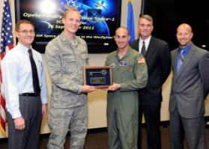

ORS-1 Lessons Learned
Unclassified Cleared for Public Release
ORS-1 proves small satellites have military utility
Refining requirements directly with warfighter results in out-of-the-box solutions that work
A small, agile team is key to executing quickly & efficiently
It is challenging but possible to “go fast in acquisition”
Adequate and stable funding are an absolute necessity
Senior leadership buy-in and advocacy required
Prototyping operational capability more complicated and costly than building S&T experiment
Do not use “technology development” to meet urgent needs
Tailor testing requirements but “test like you fly”
ORS-1 Transitioned to AFSPC and Operated by 1 SOPS
Unclassified Cleared for Public Release

Slide 15

ORS – A National Initiative
Unclassified Cleared for Public Release
ESC
MIT/LL
SDI
DoD EA for Space
NRO / NSA / NGA
NASA / NRL / DARPA
NASA Goddard
JFCC ISR / JTF-GNO
Navy NETWARCOM
APL
USSTRATCOM
NASA Ames
SDL
AFSPC
JFCC SPACE
JPL
LANL
Army/SMDC
NASA MSFC
AFSPC/SMC
NASA
Wallops
NM Spaceport
ORS Office
SMC/SDD
AFRL
SNL
SPAWAR
SPAWAR
CCAFS
NASA KSC
SOUTHCOM
NASA
JSC
CENTCOM
SOCOM
Kodiak Launch
Complex
PMRF
PACOM
UH
Innovation and Integration through Collaboration
Unclassified Cleared for Public Release

Slide 16
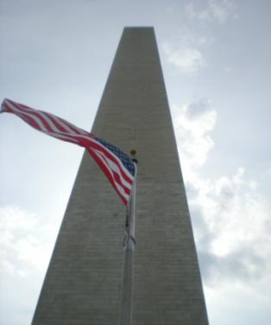

ORS -- Avenue for Innovation
Unclassified Cleared for Public Release
Small satellite systems are technically mature
Fielded quickly (~32 months for ORS-1)
Provide “good enough”, relevant capabilities
Proven with multiple phenomenologies through USCENTCOM’s ORS-1, TacSat-3 and TacSat-4
ORS embraces a flexible business model
Accepting of disruptive innovation
Adaptable, and complementary to the existing NSS architecture
Rapid and cost effective to develop and deploy space capabilities
ORS provides focus for operational advantage
Serves the disadvantaged user
Reduces high demand on existing assets
ORS-1 Wallops Jun 11
TacSat-4 Kodiak Sep 11
Unclassified Cleared for Public Release

